Slide 1
Radium Sorption Results
Michael Chen, Benjamin Kocar
Supergroup, April 27th, 2016

Slide 2
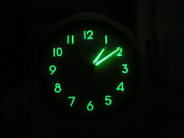
Refresher: Radium isotopes
Naturally occurring radium isotopes
Natural hazard/tracer with little human use
Wide range of half lives
3 days – 1600 years
2 oxidation states
Tracer for subterranean groundwater discharge (SGD)
Contaminant in deep water activity (ie, fracking)
Clock using radium for illumination from en.Wikipedia.org/Radium_dials

Slide 3
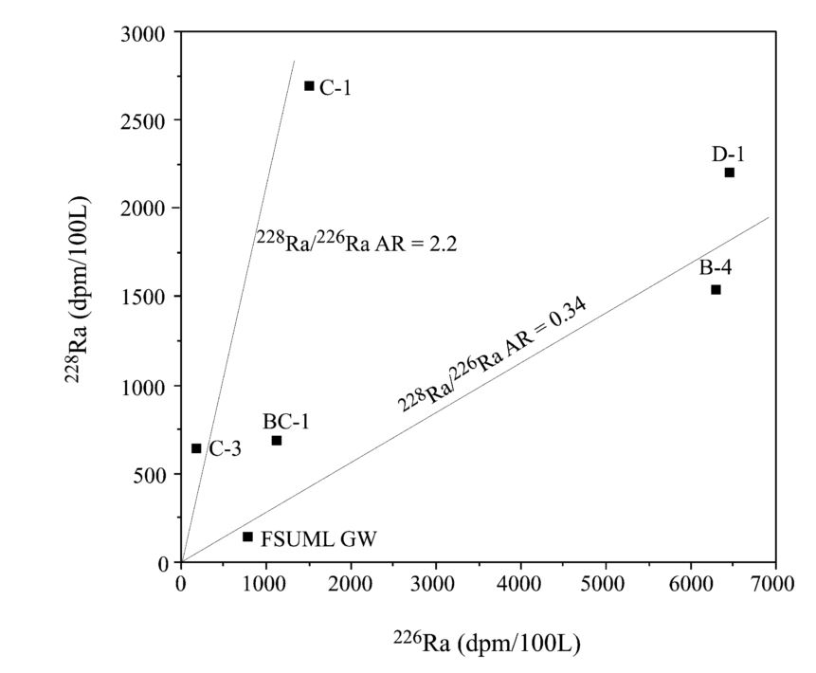
Radium as SGD tracer
Radium isotope mixing model for nearshore system
Source:
Groundwater
Sink:
Decay
Assumes conservative mixing of isotopic ratios
Figure adapted from Moore, 2003, illustrating the identification of radium sources for a nearshore system.

Slide 4
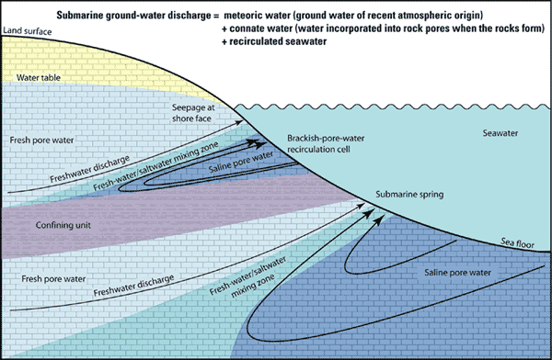
Is radium transport conservative?
Figure depicting components of SGD:https://walrus.wr.usgs.gov/sgd/overview.html

Slide 5
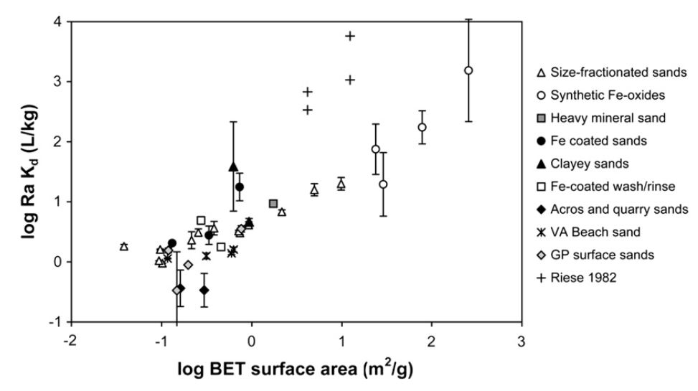
“Historical” data: large variability
DATA SLIDE
Radium sorption to marine sands in seawater from Beck & Cochran, 2013

Slide 6
Goal: Quantify radium transport behavior
Batch isotherms on a variety of minerals
Ferrihydrite
Goethite
Sodium Montmorillonite
Pyrite -> results still equilibrating
Surface complexation modeling
Establish simple parameters to compare sorption extent between minerals

Slide 7
Isotherm Parameters
Set up
10 mM NaCl solution
0.03 g in 100 mL solution (0.04 g for pyrite)
0.1-5 Bq/mL total Radium 226
Adjust pH with small volumes of HCl or NaOH to 3,5,7, or 9
Quantification
Sample supernatant by filtration through 0.2 micron filter
In some cases collect solid
Seal samples for 30 days and count on scintillation counter
Gamma count solid samples

Slide 8
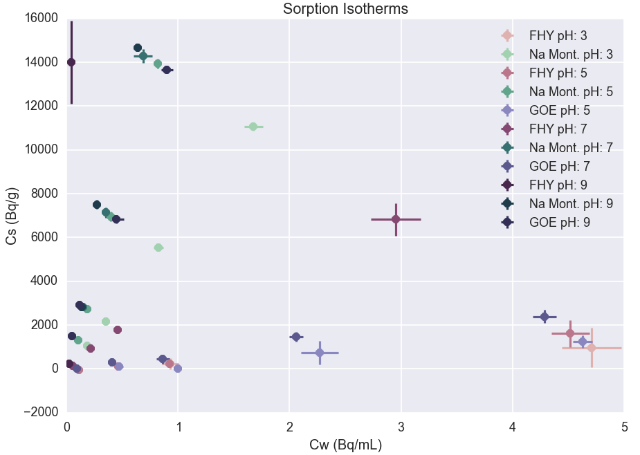

Slide 9
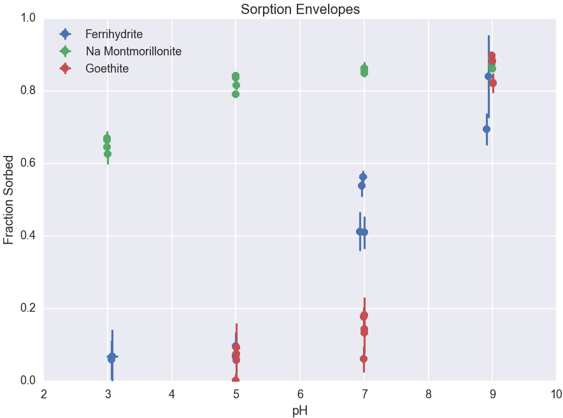

Slide 10
Surface Complexation Modeling
Sajih, 2014 proposes tetradentate reactions to ferrihydrite based on x-ray spectroscopy studies on other materials
Opt for simpler models:
Single site model or Strong and weak site model (Dzombak and Morel)
Double Diffuse Layer vs Non electrostatic model
Scan through surface reaction log K and number of surface sites to qualitatively fit data

Slide 11
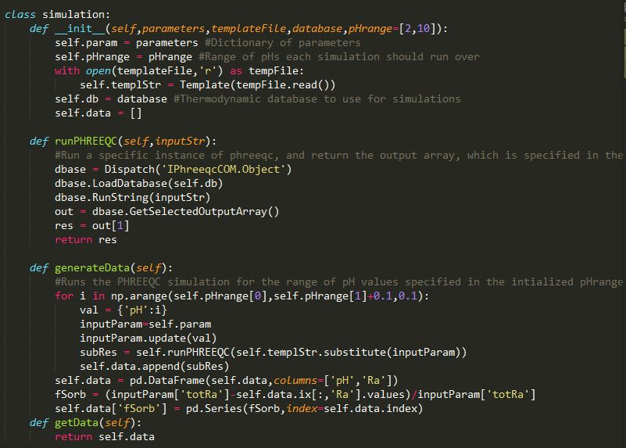
Surface Complexation with PHREEQC and Python

Slide 12
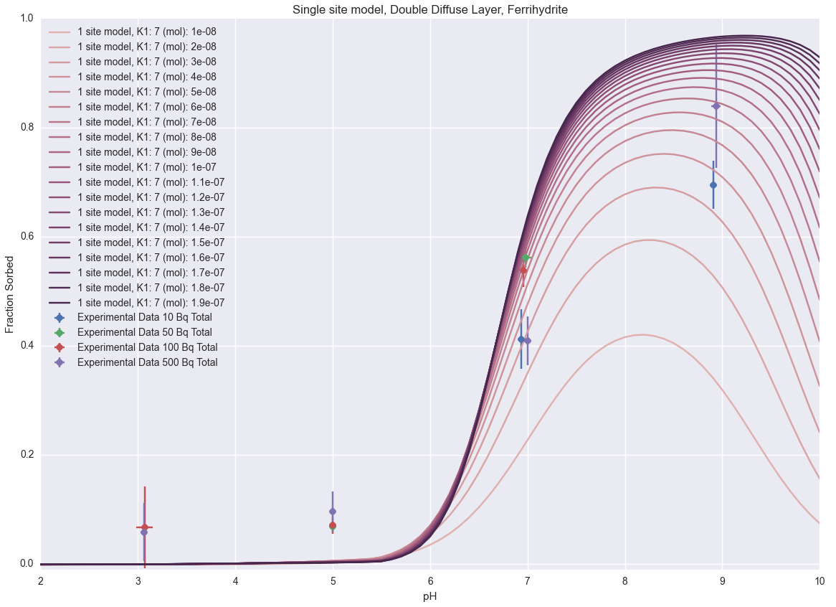

Slide 13
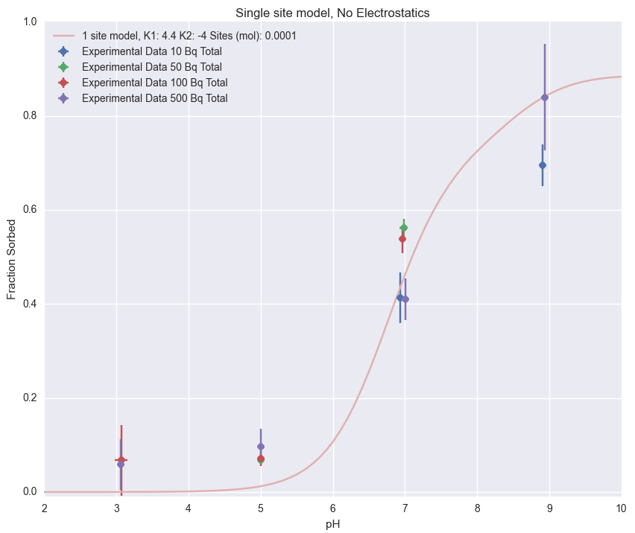

Slide 14
